Slide 1
Human Resource Management and leadership techniques

Slide 2

It’s not just what you see!
In our normal day to day routine we usually see only half of what is happening – like this tree shown here. We see the trunk, branches and leaves in all their glory but it takes a root system just as big to support the healthy tree that we see. And it is the same for organizations. Without a strong human resource practice and function as your root system, your organization will not be healthy and vibrant and able to grow.

Slide 3
What is HR?
Human Resources is the function that manages the people within an organization and gives guidance in the areas of staffing, compensation, benefits, training and development, performance appraisal, health and safety, labour relations, employee engagement, wellness and any issues dealing with employees.
And, of course, many of these areas overlap and impact each other as they change and move forward. Having a basic understanding will help to reduce the risk of lawsuits while a better understanding will help your organization to be successful.

Slide 4
Why is it important?
For most organizations, it is the employees who make the product or transact the business that makes the organization successful.
Without the proper policies and procedures in place, work is not handled properly, productivity is low and increases costs, and the organization loses the opportunity to improve and grow.
Without the proper management of employees, costs go up (absenteeism) and efficiencies are missed (better ways of doing things).
Get HR or a good lawyer!

Slide 5
What does it impact?
Without HR guiding the way, decisions get made that can be legally challenged at a significant cost.
Without proper policies in workplace, employees take advantage of the organization and there are no ways to resolve issues because there are no standard rules.
Lack of consistent direction to the employees means decreased productivity and loss of potential income.
Inconsistent and unfair treatment leads to employees leaving and costs for replacement.

Slide 6
Human Capital
Collective value of the knowledge, skills, life experiences, and motivation of an organizational workforce.
Called intellectual capital to reflect following contributions of employees:
  Thinking
  Knowledge
  Creativity
  Decision making

Slide 7
2 major influences affect how individuals perform:
Personal motivation
The type of leadership that exists
Important to look at these two concepts as interconnected and dependent on individual situations.

Slide 8
MOTIVATION
Motivation is one of the key factors driving us towards achieving something.
Without motivation, we will do nothing.
Therefore, motivation is one of the key aspects when it comes to management.
In order to achieve the best results, the organization needs to keep employees motivated.

Slide 9
Function of motivation
Simple Answer - For survival:
Organisms need to initiate adaptive behaviors
(eat, drink, sleep, etc.)
For organizational effectiveness: sometimes need to push the workers in right direction…

Slide 10
Intrinsic and Extrinsic Motivation
Intrinsic motivation causes people to participate in an activity for their own enjoyment.
Extrinsic motivation causes people to do something for a reward or to avoid a penalty.
For example, some children take piano lessons for intrinsic motivation (they enjoy it) while others take them for extrinsic motivation (to get a reward or avoid punishment).

Slide 11
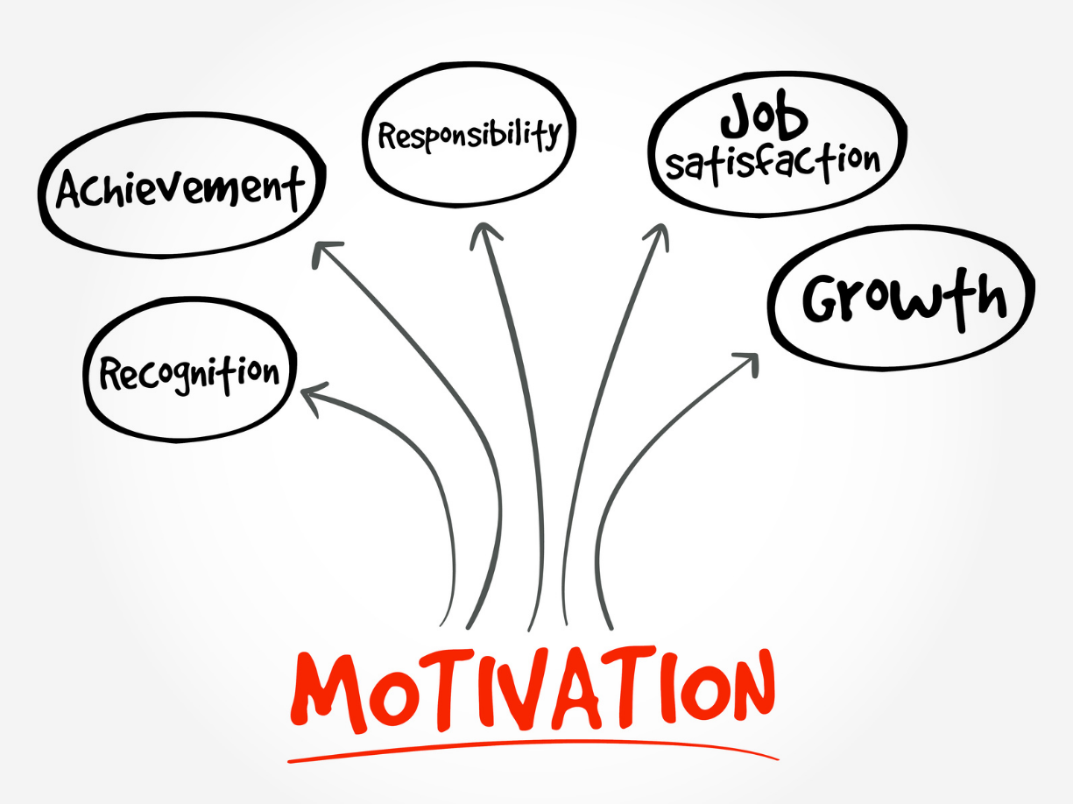
REMEMBER!
What motivates you doesn’t always motivate your staff!

Slide 12
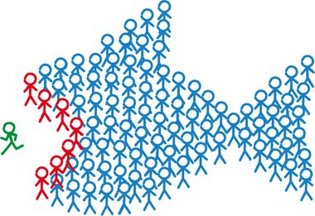
Things That Don’t Motivate
Personal Attacks
Governing by Fear
Shouldering All Responsibility
Overworking Employees
Notes:
Give constructive criticism. Feedback is important. But you should criticize only the behavior, not the person. If you find yourself saying, “You never do anything right,” stop in your tracks. Self-esteem is critical to motivation. When you do have to provide criticism, do so in private. It doesn’t help for others to overhear your words; it only makes the situation worse. Fear of repercussion never causes good performance- at least not for long. If you run your department in a finger-pointing way, your best employees won’t stay for long. And you’re certainly not fostering open communication and teamwork, which are key motivating elements. As a manager, you are paid to delegate and lead your team. If you’re doing all the “work” but neglecting those duties, you need to reexamine your priorities. Give others opportunities to learn. Not only are you making your life easier and leading by example, but you are also helping your employees feel valued and respected. Plan for peak work periods and take advantage of temporary staffing opportunities. Hire top performing temporary professional. Whatever you do, don’t overload your employees for long stretches of time. You’re giving them an invitation to find an employer who can provide a bit of balance.

Slide 13
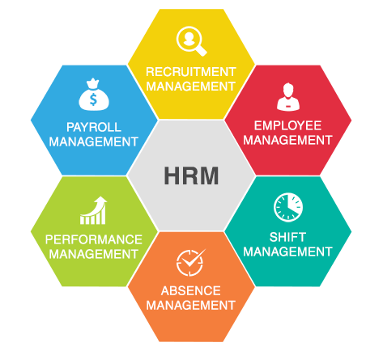
THE HRM SYSTEM

Slide 14
HRM functions -1
Planning labor needs (HR planning)
Job analysis (determining the nature of each employees job)
Recruitment and selection promotion
Training and development
Managing wages salaries, incentives and benefits (compensation management)

Slide 15
HRM functions -2
Performance management
Health and safety
Collective bargaining
Managing Relations

Slide 16
Objectives of HRM
To increase organizational effectiveness and capability
Communicating HRM policies to all employees
Helping to maintain ethical policies and socially responsible behavior
Developing and maintaining quality of work life that makes employment in the organization desirable
Managing change to the mutual advantage of individuals, groups, the enterprise, and the public

Slide 17
HRM Today
New interests and developments include human capital management, engagement management, competency-based HRM, e-HRM, performance and reward management.
Ethical dimensions: The application of HRM requires the exercise of social responsibility – it must be concerned with the interests (well-being) of employees and act ethically with regard to the needs of people in the organization and the community.

Slide 18
THank you for your attentioN!

